Slide 1
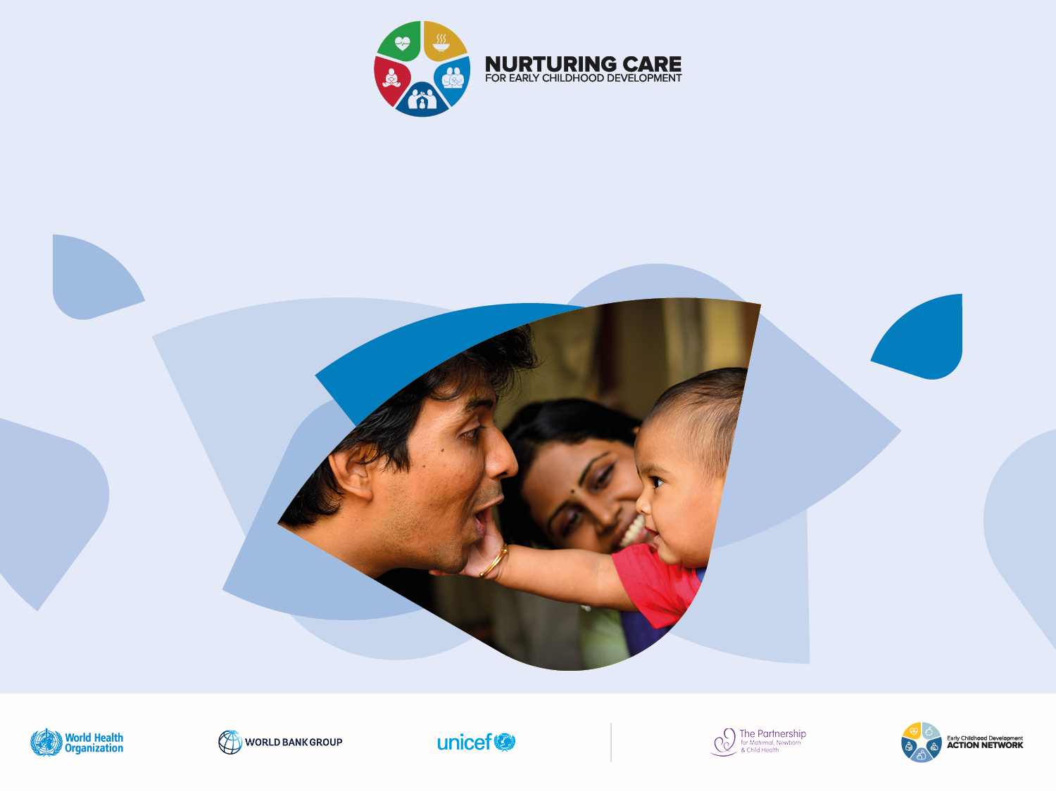
Nurturing care for helping children survive and thrive
No conflict of interest to report
Bernadette Daelmans
Department of Maternal, Newborn, Child and Adolescent Health
World Health Organization

Slide 2

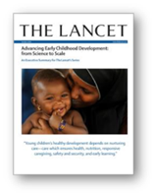
Key messages from the ECD Lancet series 2016
The early years, starting from conception, are a period of special sensitivity for child development
The most formative experience of young children come from NURTURING CARE
Early investment has lifelong and intergenerational benefits
Policies, information and services are important
Multisectoral collaboration is essential and the health sector has a special role to play

Slide 3


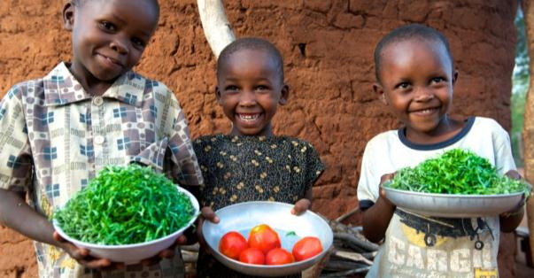
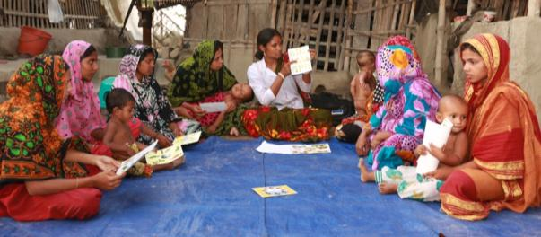
The political momentum Global Strategy for Women’s, Children’s and Adolescents’ Health 2016 - 2030
1. SURVIVE
  End preventable deaths
2. THRIVE
  Ensure health and well-being
3. TRANSFORM
  Expand enabling environments

Slide 4

Common risks to brain development
Individual level (e.g. prematurity, stunting, disability)
Family level (e.g. poverty, poor caregiving, few learning opportunities, intimate partner violence)
Community level (e.g. unclean and unsafe environments, violence, crime)
Systems level (e.g. poor health care, low quality child care)
Societal level (e.g. conflicts, humanitarian disasters)
These risks often cluster in families and communities and they affect children who are HIV exposed

Slide 5
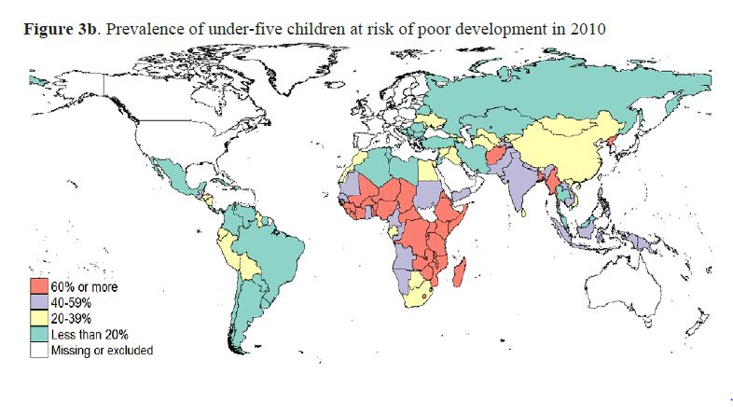
At least 250 million children are at risk of sub-optimal development
Lu C, Richter LM, Black M. Risk of poor development in young children in low-income and middle-income countries: an estimation and analysis at the global, regional, and country level, Lancet Global Health,
Volume 4, No. 12, e916–e922, December 2016

Slide 6
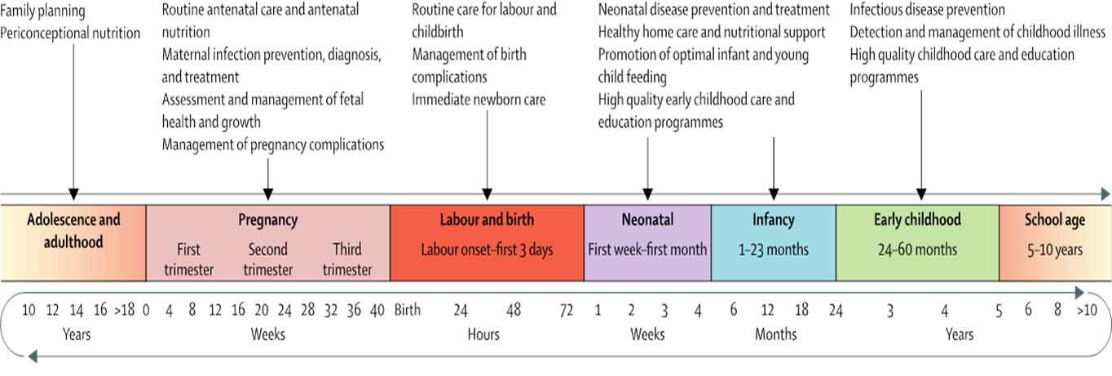
Many health and nutrition interventions have a direct impact on brain development
Source: Vaivada T, Gaffey MF, Bhutta ZA. Promoting Early Child Development With Interventions in Health and Nutrition: A Systematic Review. Pediatrics. 2017;140(2):e20164308

Slide 7
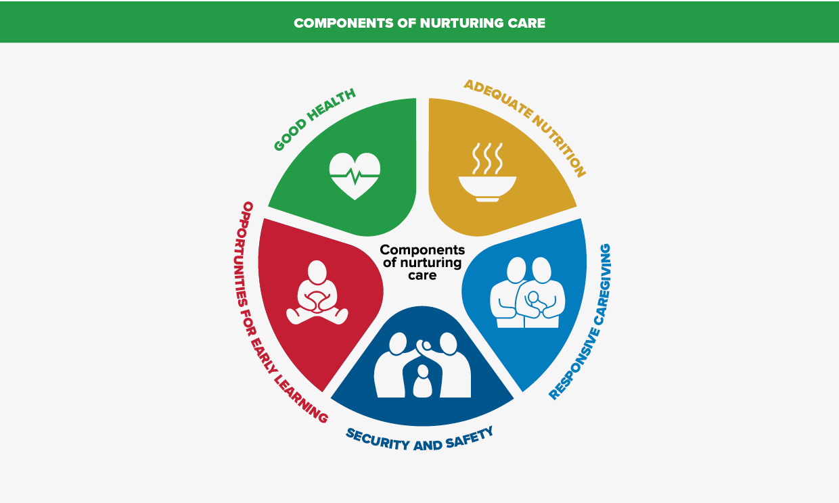
But to be sufficient, children need to receive nurturing care

Slide 8

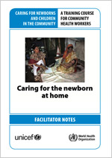
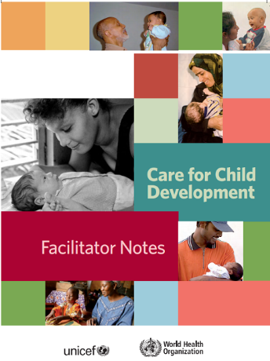
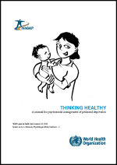
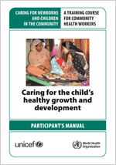
Interventions and care for both caregivers and their children
Addressing parental physical and mental health
Addressing responsive caregiving and early learning

Slide 9
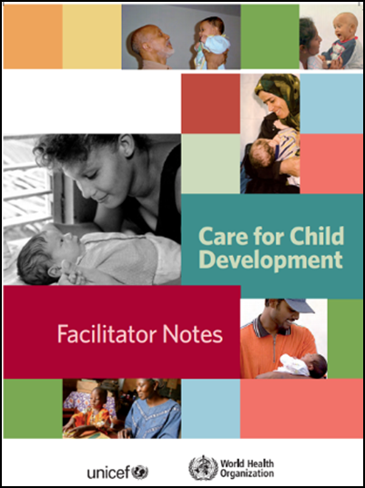
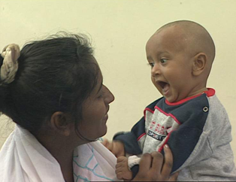
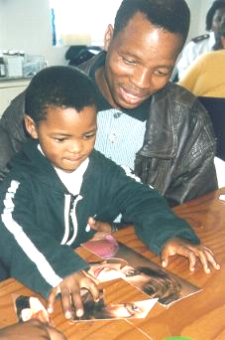
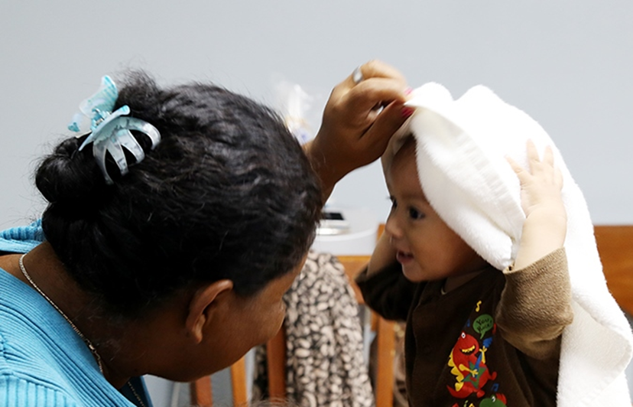
WHO/UNICEF Care for Child Development
Provides tools for counselling families on play and communication activities
Supports a positive, affectionate interaction where needs are met and the child can learn
Serves as a buffer against adversity

Slide 10

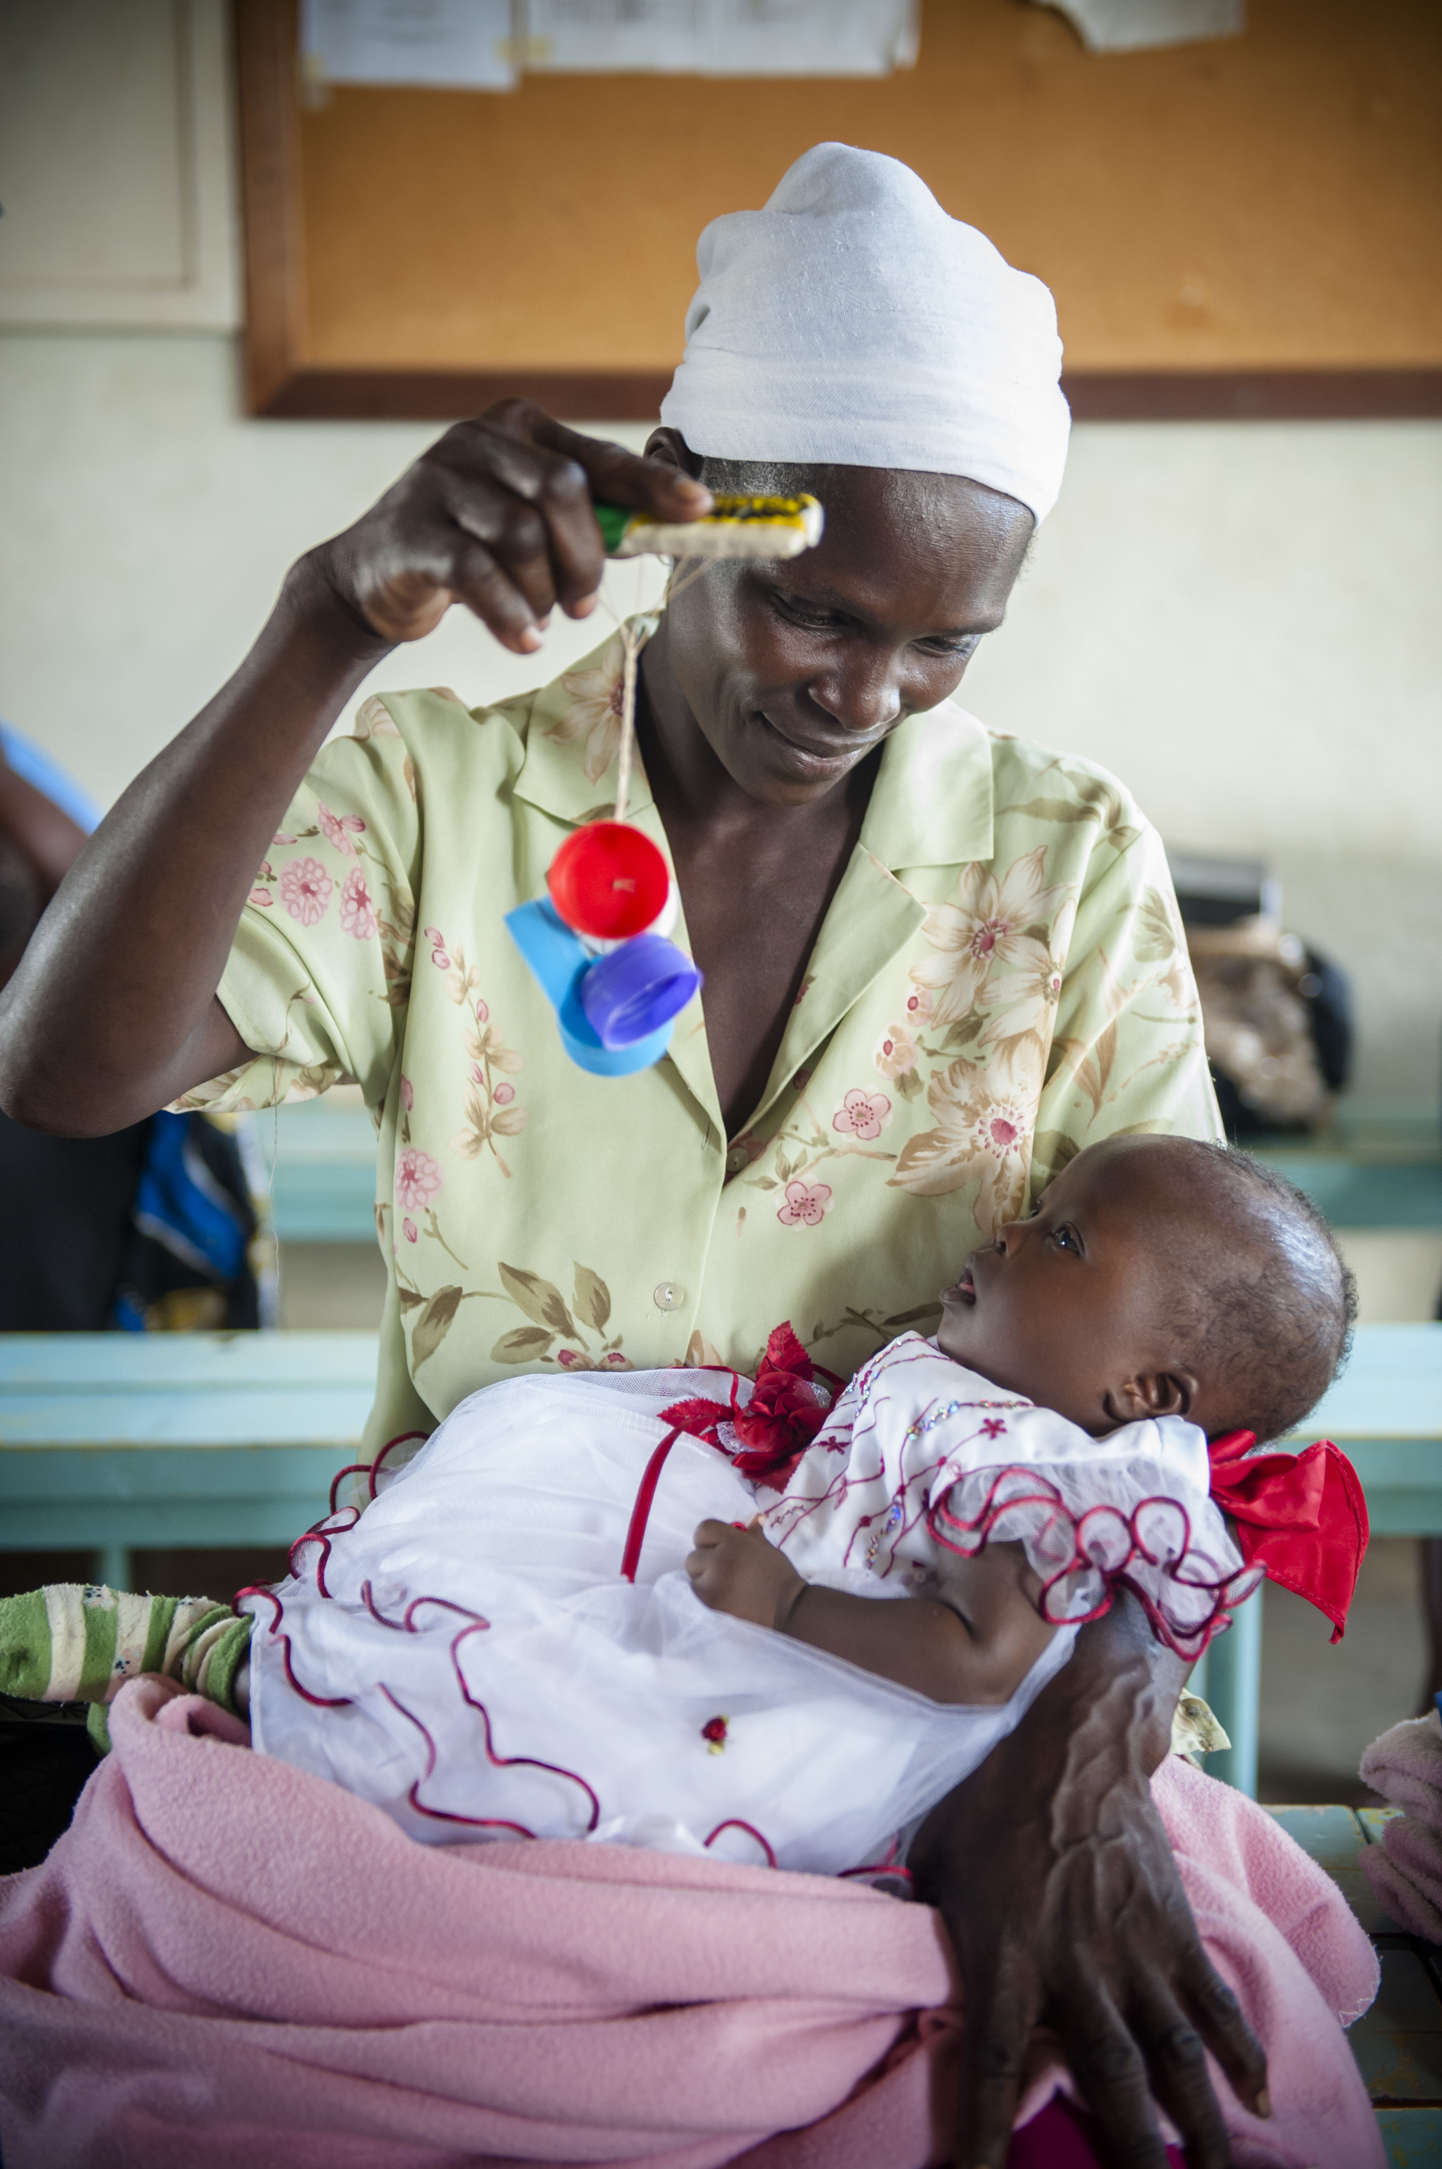
Interventions can be integrated in multiple platforms
Health and nutrition
Education
Child protection
Social protection
Antenatal care
Postnatal care
Immunization
Well child care
Sick child care
HIV prevention and care
Nutrition rehabilitation
Individual counselling
Demonstration and guided practice
Participatory learning
Home visits
Group sessions
Clinical services
Child care centres

Slide 11
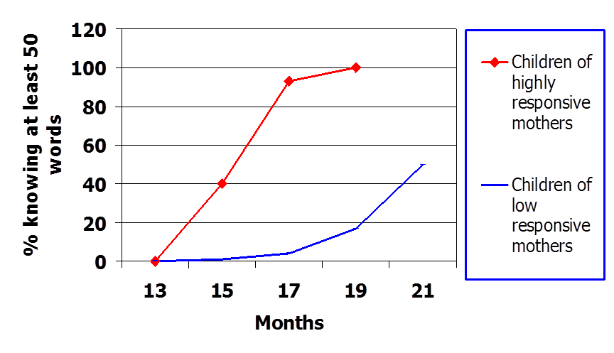
Effectiveness of responsive caregiving
Source: Tamis-LaMonde, 2001

Slide 12
Summary of child–related outcomes following CCD intervention
Nutrition | Improved feeding
 | Improved growth
Health | Fewer diarrhoea episodes
 | Fewer pneumonia episodes
Child development | Higher cognitive skills
 | Higher language skills
 | Higher motor skills
 | Higher social-emotional skills
Greatest benefits for at-risk children (children with stunting, with a depressed mother, low maternal education, poorest)

Slide 13
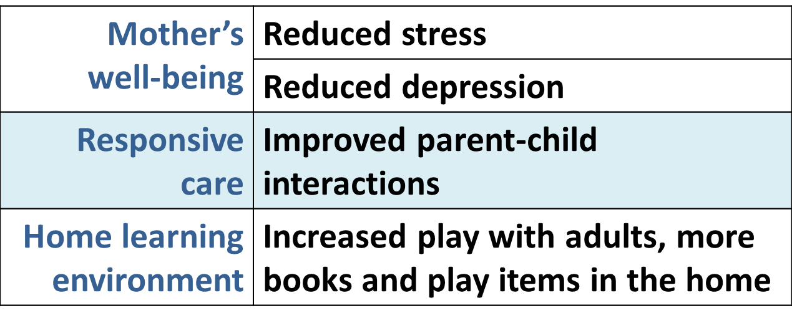
Summary of caregiver–related outcomes following CCD intervention
Source: Lucas J, Richter LM, Daelmans B. Care for Child Development: an intervention in support of responsive caregiving and early child development (2018) Child: care, health and development, 44, 1, 41 – 49

Slide 14
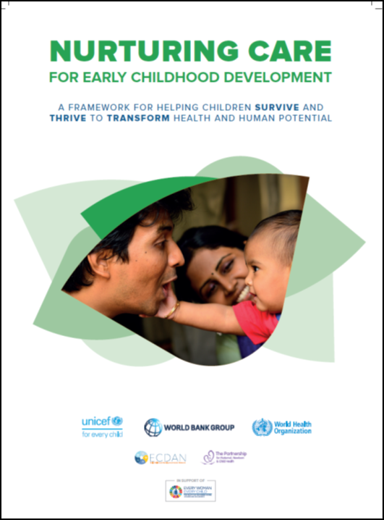
The Nurturing Care Framework
A road map that outlines:
Why efforts must begin in the earliest years, from pregnancy to age 3
How nurturing care protects children from the worst effects of adversity
What caregivers need in order to provide nurturing care

Slide 15
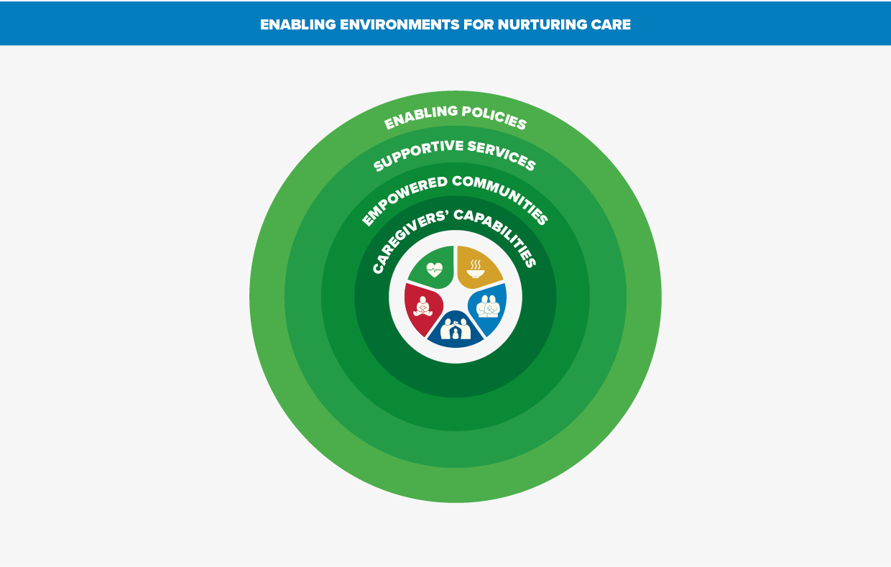
Promotes a holistic approach

Slide 16
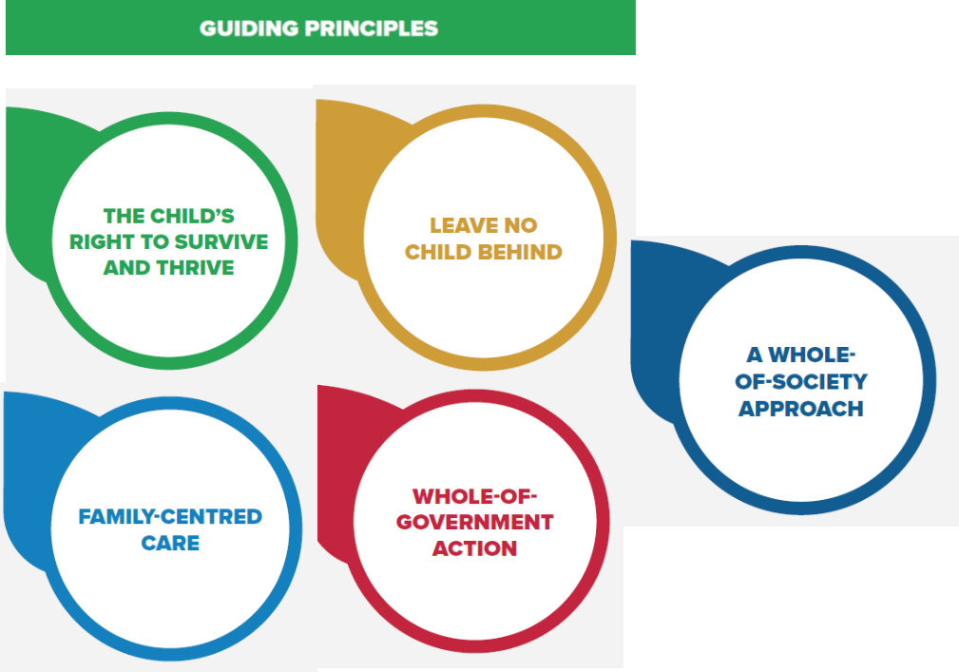
Guided by rights and inclusive participation

Slide 17
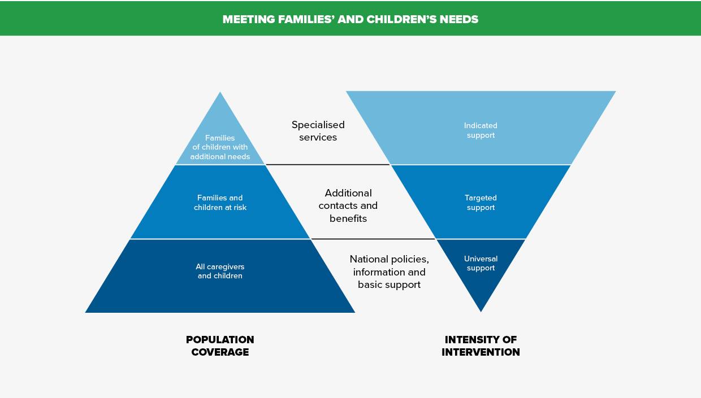
Recognizing different needs

Slide 18

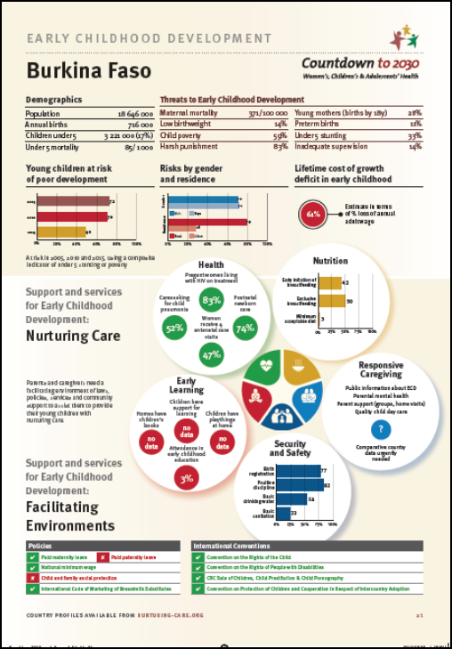
Supported by country profiles

Slide 19
Tools and implementation support
Normative and operational guidance in preparation
WHO guidelines to support nurturing care
Global measurement framework and population-based indicators
Operational guidance and global learning platform
Updated practice tools for integrated service delivery
Towards harmonized action
Engagement of ECD Action Network and PMNCH
Sensitization of global initiatives, e.g., Scaling-up Nutrition, Global Financing Facility, GFATM, GAVI and G20
UN agencies working together with governments and partners to optimize implementation approaches

Slide 20

Towards programmatic guidance
A review of the global literature and survey among partners engaged in implementation of programmes for young children affected by HIV and AIDS in southern and eastern Africa (2017):
  Paucity of papers reporting on children in low and middle income countries (23%)
  Inconclusive findings on intensity and duration of programmes, or optimized channels of intervention delivery
  Little evidence that generalized universal home visiting programmes are effective
Source:

Slide 21
Selected conclusions of the review
Home visits
  Should be reserved to address specific challenges in high risk groups
  The inclusion of fathers is associated with greater benefits
Parent groups
  Parent groups should at least occur fortnightly for about 2 hours for a period of 6 - 12 months
Early child care and education centres
  Systematic improvements are needed in community-based centres to improve child development and school readiness
Additional recommendations
  Staff should be carefully selected, well trained, and supported
  Demonstration and role play are more effective than lectures
  Interventions focussed on early learning should be closely linked with health, nutrition and social services

Slide 22
Concluding messages
Children exposed to HIV are vulnerable for sub-optimal development due to family and community fragilities and adversities
Caregivers of children exposed to HIV will benefit from additional support to provide nurturing care
Targeting the most vulnerable families with services of good intensity, quality and duration is essential
Scientific evidence of what needs to be done is strong
The political momentum is right to increase investment
But, better and standardized programme monitoring, and local and global learning, are needed for programme optimization

Slide 23
